Slide 1


INVESTIGATION OF SECONDARY METABOLITES
PRESENT IN ALKALOIDAL EXTRACTS OF HUNTERIA UMBELLATA LEAVES USING COMPUTATIONAL MOLECULAR NETWORKING TOOL
Rukayat A. Adedeji^{1*}., Musibau Opemipo¹., Oluwabukunmi Babalola¹., Solomon O. Julius²., Stephenie C. Alaribe^{1*}
Department of Pharmaceutical Chemistry, Faculty of Pharmacy, University of Lagos, Nigeria
Department of Pharmacognosy, Faculty of Pharmacy, University of Lagos, Nigeria
Presenter Contact: rukayatadedeji064@gmail.com
Abstract Number: FPC-24-018
Notes:
Good day, everyone. My name is Rukayat Adedeji, and I’m pleased to present our research on the “Investigation Of Secondary Metabolites Present In Alkaloidal Extracts Of Hunteria Umbellata Leaves Using Computational Molecular Networking Tool”.

Slide 2

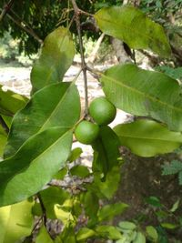
Background
Picture from www.gbif.org
Hunteria umbellata K. Schum, a tropical rainforest tree found in western and central Africa.
African traditional herbalists use various portions of the plant for a wide variety of medicinal purposes.
The aim of this study was to investigate the secondary metabolites present in the leave extract of the plant using metabolomics tools and a computational molecular networking platform.
Notes:
Hunteria umbellata K. Schum, a tropical rainforest tree found in western and central Africa. African traditional herbalists use various portions of the plant for a wide variety of medicinal purposes because of its therapeutic properties including anti-inflammatory, hypoglycemic, antihelmintic and many more.
However, the specific compounds responsible for these effects have not been fully explored. This study aims to isolate and identify the secondary metabolites of Hunteria umbellata K. Schum using computational molecular networking tools, to validate or challenge its reputed medicinal uses.

Slide 3

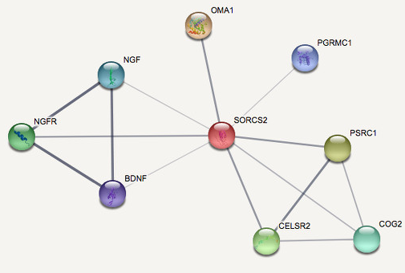

Methodology
Molecular Networking for Compounds Identification
Alkaloids extraction using Manske Method
LC-MS/MS Analysis of extracts
Global Natural Product Social Molecular Networking (GNPS)
Notes:
In achieving our objective, we extract the alkaloid contents from the leaves using Manske method.
Then isolate, purify, and identify the secondary metabolites present in the crude alkaloidal extract using LC-MS/MS. Liquid chromatography-tandem mass spectrometry (LC-MS/MS) is a metabolomics tool that uses mass data of components to exhaustively elucidate these components beyond what a simple spectroscopic tool like Nuclear Magnetic Resnance (NMR) would do. LC-MS/MS is a highly sensitive technique for target analysis of small molecules. It will account for the total ions present and thus would identify any compound or fragments attached to a major compound. The LC-MS/MS setup is usually integrated with online MS databases for several reference compounds.
Finally, the characterization of the secondary metabolites identified using a computational molecular tool with a mass spectral library data bank. The computational tool used in this research is the Global Natural Products Social Molecular Networking(GNPS) platform.
GNPS is an open-access knowledge base for the community-wide organization and sharing of raw, processed, or identified tandem mass (MS/MS) spectrometry data. GNPS can be used for molecular networking, a spectral correlation and visualization approach that can detect sets of spectra from related molecules, even when the spectra themselves are not matched to any known compounds. Spectral alignment detects similar spectra from structurally related molecules, assuming these molecules fragment in similar ways reflected in their MS/MS patterns.
This tool enables a cycle of annotation in which users curate data, continuous dereplication enables product identification, and a knowledge base of reference spectral libraries and public data sets are created.

Slide 4
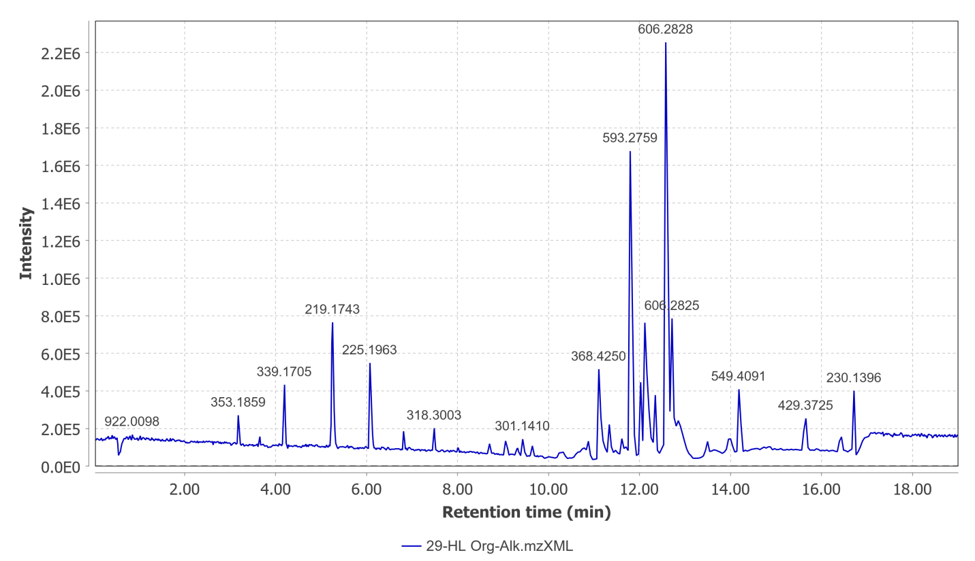
Results
Several alkaloids were isolated as shown in the chromatogram
3 unique compounds identified:
Picrinine
IUPAC: Methyl 14-ethylidene-18-oxa-2,12- diazahexacyclo[9.6.1.19,15.01,9.03,8.012,17]nonadeca -3,5,7-triene-19-carboxylate
(3beta,5xi,9xi,13alpha,17alpha,18xi)-3-Hydroxy-13,28-epoxyurs-11-en-28-one
Pheophorbide A
IUPAC: (3S,4S)-9-Ethenyl-14-ethyl-21- (methoxycarbonyl)-4,8,13,18-tetramethyl-20- oxo-3-phorbinepropanoic acid
Chromatogram showing the spectrum peaks of the isolated compounds in the alkaloidal extract
Notes:
The presence of multiple peaks suggests that a diverse mixture of compounds was isolated. Through the molecular networking feature of GNPS, we identified three alkaloids.
Pheophorbide A, a compound with strong potential in cancer therapy, is known for its effectiveness as a photosensitizer, making it valuable in photodynamic therapy for cancer treatment. Picrinine, a monoterpenoid indole alkaloid, has been researched for its anti-inflammatory properties and may be useful as an antitussive, expectorant, and for asthma relief.
The third compound identified is a relatively new moiety with limited information available in the literature. Further studies are needed to determine its medicinal potential or any toxic effects on cells.

Slide 5
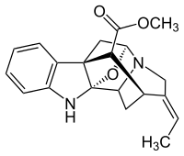
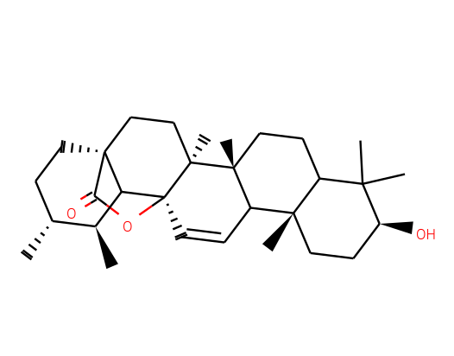
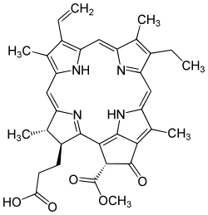
Results
(3beta,5xi,9xi,13alpha,17alpha,18xi)-3-Hydroxy-13,28-epoxyurs-11-en-28-one
Picrinine
Pheophorbide A
Notes:
The presence of multiple peaks suggests that a diverse mixture of compounds was isolated. Through the molecular networking feature of GNPS, we identified three alkaloids.
Pheophorbide A, a compound with strong potential in cancer therapy, is known for its effectiveness as a photosensitizer, making it valuable in photodynamic therapy for cancer treatment. Picrinine, a monoterpenoid indole alkaloid, has been researched for its anti-inflammatory properties and may be useful as an antitussive, expectorant, and for asthma relief.
The third compound identified is a relatively new moiety with limited information available in the literature. Further studies are needed to determine its medicinal potential or any toxic effects on cells.

Slide 6

Conclusion
Hunteria umbellata demonstrates significant pharmacological potential, highlighted by the rich presence of secondary metabolites in its leaves. Several identified compounds have been associated with therapeutic activities in pharmacological studies. The discovery of both known and novel compounds emphasizes the need for further research in drug development and natural product chemistry.
References
Fox Ramos, A.E., Pavesi, C., Litaudon, M., Dumontet, V., Poupon, E., Champy, P., Genta-Jouve, G. and Beniddir, M.A., 2019. CANPA: computer-assisted natural products anticipation. Analytical chemistry, 91(17), pp.11247-11252.
Stafford, G. I., Jäger, A. K., & Van Staden, J., 2009. African psychoactive plants. African Natural Plant Products: New Discoveries and Challenges in Chemistry and Quality, 323, 346.
Wang, M., Carver, J.J., Phelan, V.V., Sanchez, L.M., Garg, N., Peng, Y., Nguyen, D.D., Watrous, J., Kapono, C.A., Luzzatto-Knaan, T. and Porto, C., 2016. Sharing and community curation of mass spectrometry data with Global Natural Products Social Molecular Networking. Nature biotechnology, 34(8), pp.828-837.
Notes:
Hunteria umbellata demonstrates significant pharmacological potential, highlighted by the rich presence of secondary metabolites in its leaves. Several identified compounds have been associated with therapeutic activities in pharmacological studies. The discovery of both known and novel compounds emphasizes the need for further research in drug development and natural product chemistry.

